Slide 1




Research on Complex networks key nodes and community structure mining
Central South University
School of Computer Science & Engineering Major: Computer Science and Technology
Presenter：Aman Ullah Mentor: Dr. Prof. Wang Bin
延时文字

Slide 2


CONTENTS
Identifying key nodes based on neighborhood and path information
Evaluating and measuring key nodes influence using local structure model in complex networks
A relevance-based information interaction model for community detection in complex networks
Identification of key nodes based on local and global topological aspects
Conclusions
Introduction

Slide 3
Introduction
A brief overview of complex networks
Part 1
Background and significance
Current research status
Research content and objective
Organization of the thesis
The main contributions

Slide 4
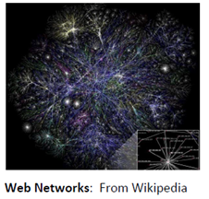
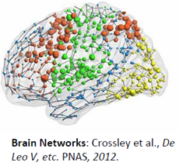
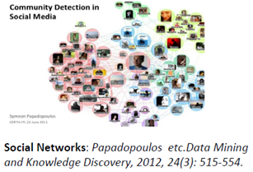
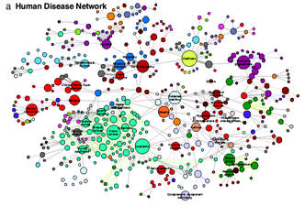
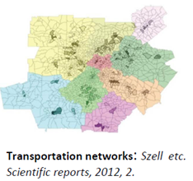
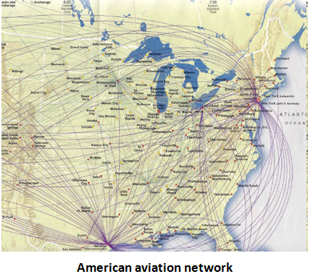
1.1 A brief overview of complex networks
Various networks can be used to describe complex systems in nature

Slide 5

1.1 A brief overview of complex networks
Definition
Complex networks consist of nodes and links, where nodes are used to represent different individuals in the real system, and edges are used to represent the relationship between individuals
Many real-world phenomena can be displayed as networks. A complex network is one that is self-organizing, self-matching, engaging, small world, and scale-free. Ref- Qian Xuesen
Notes:
We define a complex network as a set of nodes and links. This sounds hard to understand but it is quite the opposite. For instance, you might have heard about the concept of social network. A social network is a representation of the relationships among people. Each individual is a node and two nodes are connected by a link if they know each other. Think about you and your friends and family. Your relationships with them construct your social network. Each one of you is a node of the network and each relationship is a link.

Slide 6
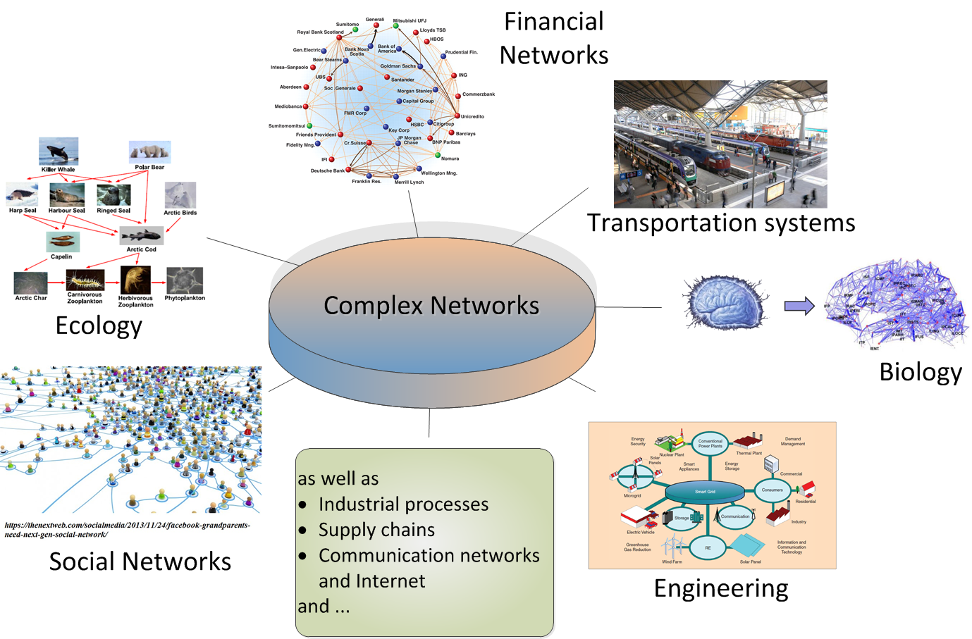
1.1 A brief overview of complex networks
Large-scale systems are everywhere!
We are living in a world of large-scale systems which are sometimes small in size!
Notes:
We define a complex network as a set of nodes and links. This sounds hard to understand but it is quite the opposite. For instance, you might have heard about the concept of social network. A social network is a representation of the relationships among people. Each individual is a node and two nodes are connected by a link if they know each other. Think about you and your friends and family. Your relationships with them construct your social network. Each one of you is a node of the network and each relationship is a link.

Slide 7
1.2 Background and significance
Complex network has been incorporated into various fields, such as physics, mathematics, biology, sociology, and computer science, and is now one of the most multidisciplinary sciences. In many fields, complex networks provide a natural and powerful way to model complex real-world systems. With the rapid growth of network data, scale and complexity of the network also increase rapidly, leading to higher requirements and challenges to mining accuracy, scalability, and ease of use of complex network structures
In real life, on average, how many people know each other ？
How do online and offline news and public opinion spread in our real society？
How do different infectious diseases spread so fast among people all over the world ？
Complex Network
How many clicks do we need on average when searching for a web page on any search engine ？
How can our brain think and work efficiently ？
How do rumors spread in our society ？

Slide 8
1.2 Background and significance
1
2
3
4
Social sector
Public utilities sector
Information Technology
Biological field
Disease transmission and immunization, software virus infection and disinfection,
increased product exposure and rumor suppression, Detection of criminal gangs, intelligent recommendation, precision marketing, public opinion early warning, group event monitor, and network group event monitoring
Identify key nodes in the power grid network, Identify key nodes in road or routes in the transportation network.
Search engines (Baidu and Google), influence analysis, route optimization, and distribution of information.
Protein networks, metabolic networks can be used to predict which nodes might interact, and they can be used to analyze important species in food chains

Slide 9
1.3 Current research status
Characteristics of complex networks
Research on influential nodes identification
Research on community detection
The complexity of complex networks
Small world characteristics
Scale-free characteristics clustering characteristics
Local-based nodes detection
Global-based nodes detection
Local and Global-based nodes detection
Local-based community detection
Local and Global-based community detection
From Micro-level
From Meso-level
Influential nodes identification in complex networks
Community detection in complex networks

Slide 10
1.4 Research content and objective
On the micro-level
On the meso-level
Challenges & issues
Existing approaches for key node detection
Existing community detection approaches
Shortcoming
Time Complexity
Accuracy
Parameters-oriented

Slide 11
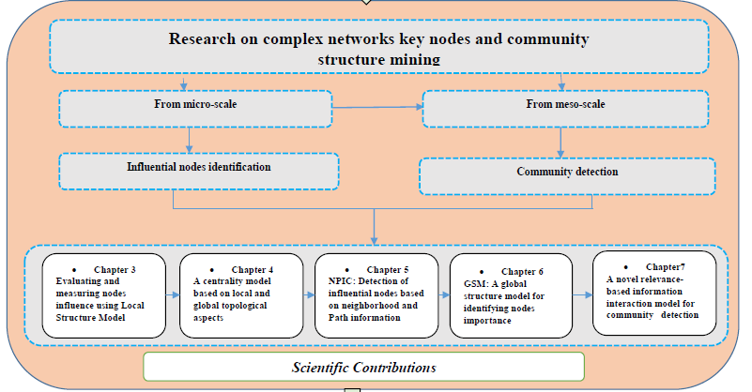
1.5 Organization of the thesis

Slide 12
1.6 The main contributions
Proposed RIIM
A relevance-based information interaction model (RIIM) is proposed that analyzes local as well as global topological aspects of complex networks without providing prior community knowledge or setting parameters beforehand
Proposed NPIC
A Centrality (NPIC) method is proposed, which considers the degree and position of nodes in a network to detect influential
nodes in complex networks.
Proposed LGC
Designed a Local-and-Global Centrality (LGC) measuring algorithm that identifies the vital nodes and works simultaneously with local and global network topological aspects
Proposed LSM
A local structure model (LSM) is proposed to identify influential nodes based on local information of a node in a network

Slide 13
Evaluating and measuring nodes influence using local structure model in complex networks
Identification of influential nodes Overview
Part 2
Our Proposed LSM
Experimentation and results analysis
Summary, advantages and disadvantages
of the proposed LSM

Slide 14
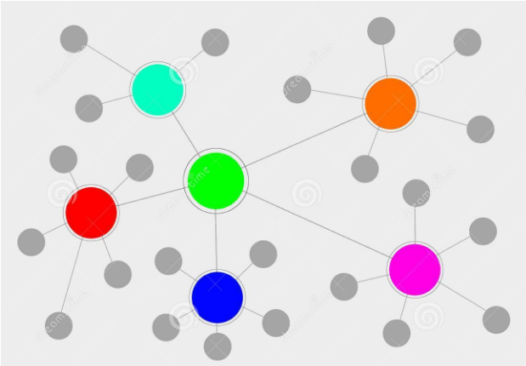
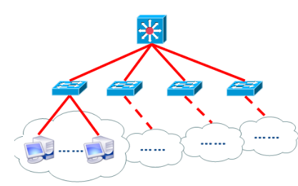
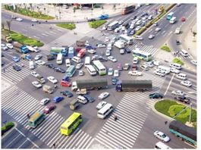
2.1 Identification of influential nodes Overview
Influential/ key node nodes
In complex networks, key nodes are nodes that can have a greater impact on the structure and function of the network than other nodes

Slide 15
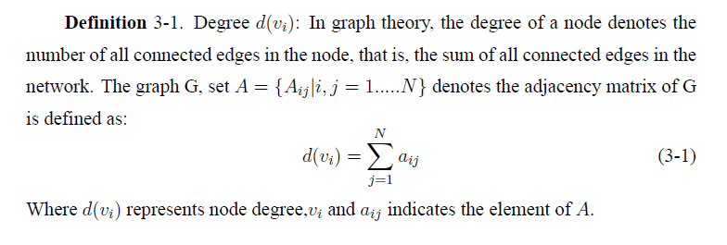
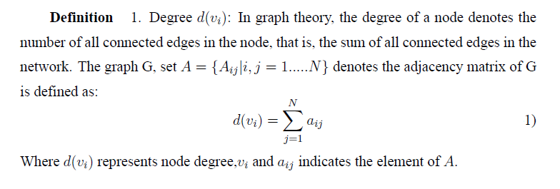
2.2 Our Proposed LSM
A variety of indexing or centrality algorithms for finding influential nodes have been offered in the literature, such as BC, CC,PR etc., have issues e.g high time complexity
Using the local information of the complex network, we propose the local structure model (LSM) for identifying influential nodes
LSM comprises factors such as the k-shell, degree nodes, number of triangles, and numerous levels of neighbor's influence or neighborhood potential
Introduce some basic concepts and definitions concerning LSM

Slide 16
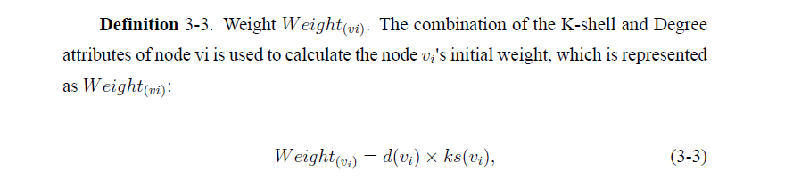
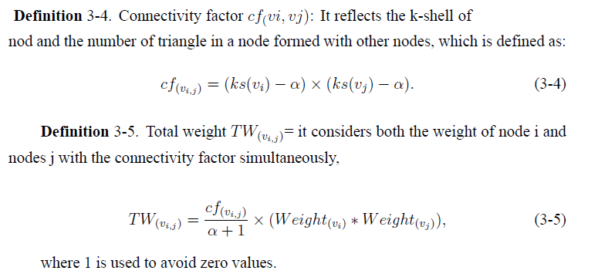
2.2 Continue....

Slide 17
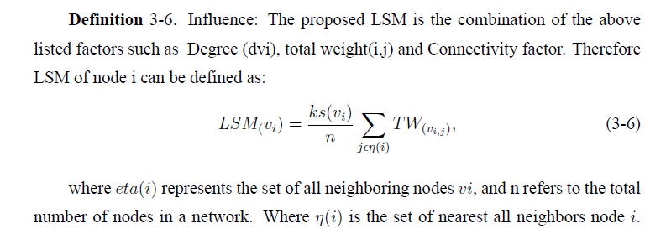
2.2 Continue....

Slide 18
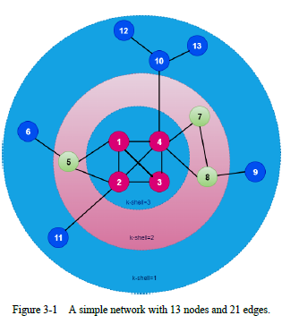
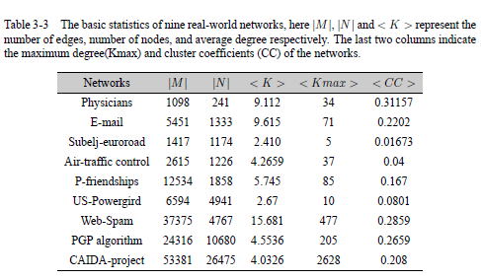
2.3 Experimentation and results analysis
01
Running example of LSM
02
Real-world datasets
03
Evaluation metrics
04
Effectiveness

Slide 19
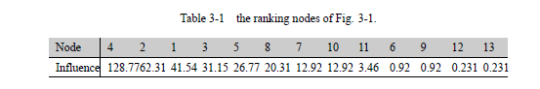
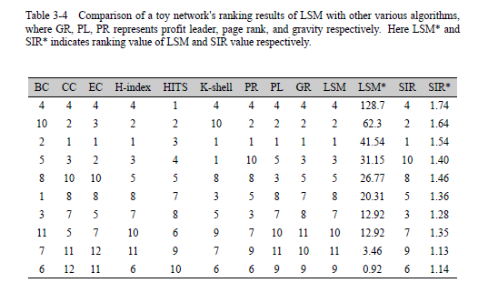
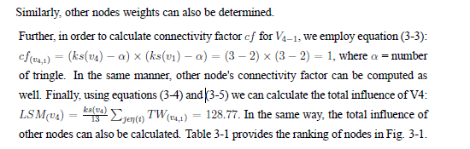
2.3 Continue...

Slide 20
2.3 Continue...
SIR
Kendall
03
Evaluation measures
01
Comparing approaches
Experimentations
04
Result
02
Data set
1.K-shell
2. H-index
3. Betweenness Centrality 4. Closeness Centrality 5. Eigenvector Centrality
6. HITS 7. PageRank 8. Profit-leader concept 9. Gravity Centrality

Slide 21
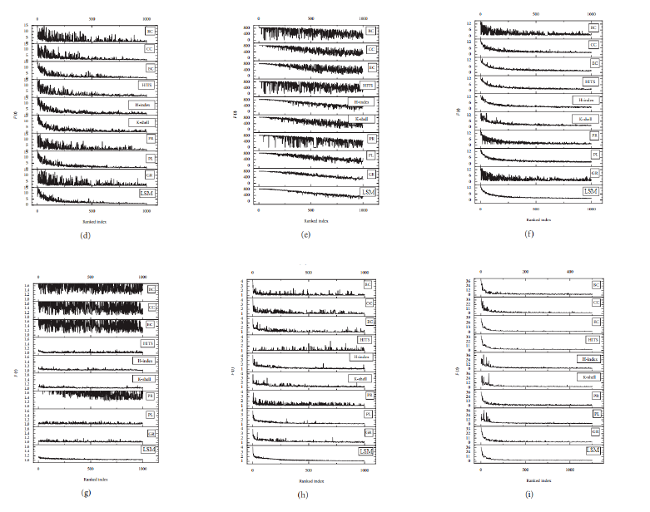
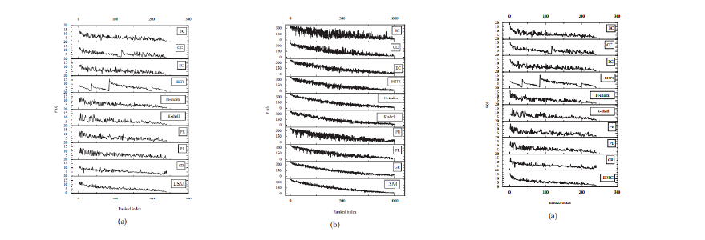
2.3 Continue...
The SIR model for spreading the impact of the ranked nodes, relatively small β for big networks such as PGP algorithm and CAIDA-project. Especially, β = 0.01 due to the bigger value, the propagation will occur across the whole networks
For small networks such as (Web-spam, US-powergrid, Physicians, E-mail, Subelij-eroroad, Petster-friendships, and Air traffic control), set β = 0.1 to estimate the influences of each node
Calculate the average number of nodes infected per seed node over 1000 runs
Notes:
We used the SIR model for spreading the impact of the ranked nodes, where we used a relatively small β for big networks such as PGP algorithm and CAIDA-project. Especially, we have set
β = 0.01 due to the bigger value, the propagation will occur across the whole networks. in this situation, it will be hard to separate the influence of different nodes.

Slide 22
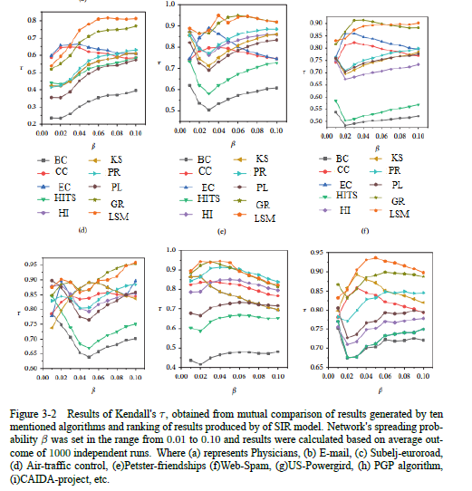
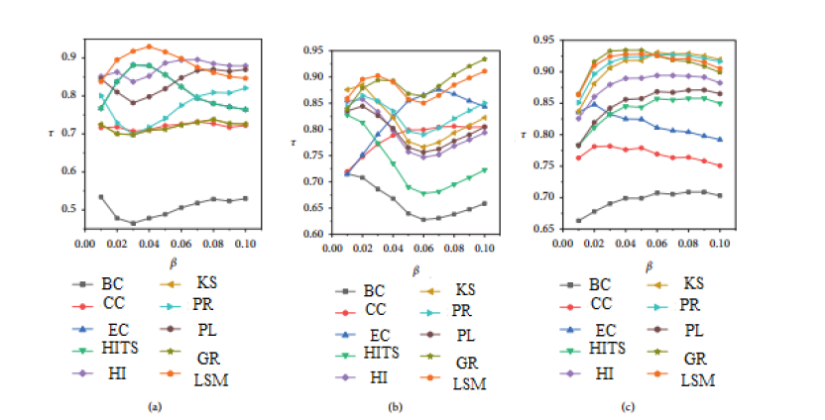
2.3 Continue...
Kendall's τ correlation coefficients is employed
The results in the range between 0.8 and 1. Such as 0.9 for Physicians and Web-spam, 0.95 for E-mail, Subelj-euroroad, CAIDA-project and USpowergrid, 1.0 for PGP algorithm and Petster-friendships respectively

Slide 23
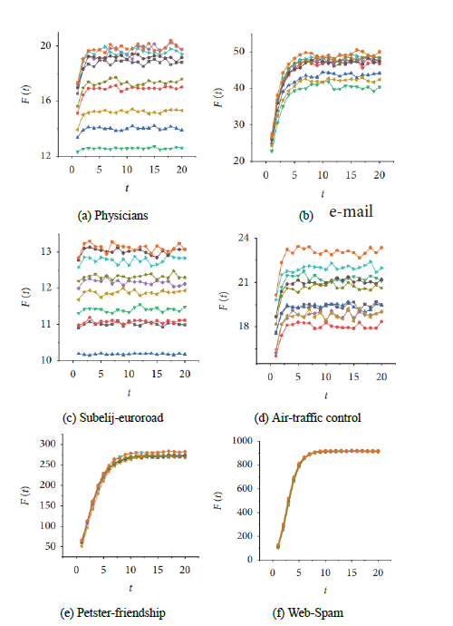
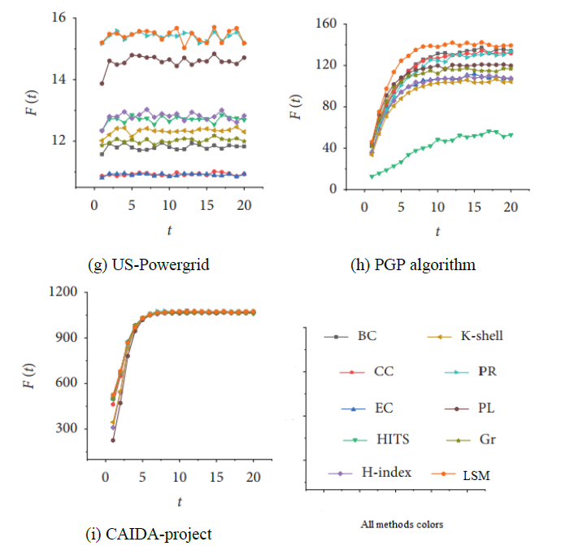
2.3 Continue...
The propagation effect of the first 10 different nodes on different networks
LSM has better performance on the Physicians, E-mail, Subeljeuroroad, Air-traffic control, Petster-friendships and PGP algorithm US-Powergird networks. In Petster-friendships, and CAIDA project networks, PR and EC have the best propagation effect

Slide 24
2.4 Summary, advantages and disadvantages
local structure-based centrality (LSM), which considers local information rather than global information of nodes in a network
A new raking centrality perspective
High Performance
Parameter-Free
On the basis of local information of a network, proposed a novel approach to identify influential nodes called locality-based model (LSM)
LSM is comparatively more effective and efficient algorithm. Compare with recent methods
LSM neither depends on prior knowledge nor rely on adjustments of parameters.

Slide 25
2.4 Summary, advantages and disadvantages
LSM can be employed on large scale networks
Applied several types of real-world networks and used two standard evaluation criteria, SIR and Kendall's correlation coefficient τ methods, to analyze the spreading influence of ranking nodes
Experimental setup demonstrated that the proposed algorithm regarding accuracy and effectiveness is reasonable and significant as compared to the classical sorting algorithms
The main limitation of the proposed LSM is that it considers very limited information (local information of a node in a network) and is unable to efficiently identify path information between the nodes (global information)
High Performance
Notes:
Further, this motivation is guided us to design an indexing method based both local and global connectivity
structures which is presented in the next slid.

Slide 26
A centrality model based on local and global topological aspects for influential nodes identification
Overview of previous LSM model limitations
Part 3
Proposed LGC
Experimental analysis
Effectiveness
Summary, advantages and disadvantages of the proposed LGC

Slide 27
3.1 Overview of previous LSM model limitations
The limitation of the proposed LSM is that it considers very limited information (local information of a node in a network) and is unable to efficiently identify path information between the nodes
In order to overcome this problem, proposed local and global centrality (LGC)
Considers local and global information
Comprises factors like degree of nodes, shortest path distance, and numerous levels of neighbor's influence or neighborhood potential
The performance of LGC is evaluated on 6 real-world networks and used SIR and Kendall model
LGC outperformed many of the compared techniques

Slide 28
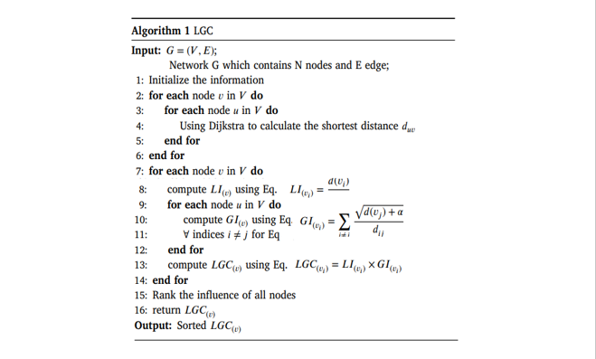
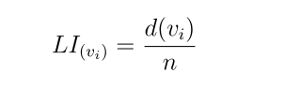
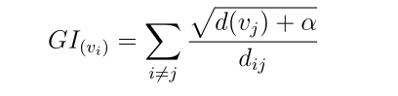
3.2 Proposed LGC
Local-Influence: Local influence of node 𝑣𝑖 represents the local information of graph G (divide the degree of node 𝑖 by the total number of nodes in the graph G represented by 𝐿𝐼(𝑣𝑖), which is defined as:
where 𝑑(𝑣𝑖) and n represent the degree of node 𝑖 and total number ofnodes in a network.
Global-Influence: The node not only influences itself but also considers the influence of neighboring nodes. The global-influence is represented by 𝐺𝐼(𝑣𝑖), and can be defined as:
the tunable parameter 𝛼 controls the influence of degree in anetwork. It lies in the range between 0 and 1, the square root is used to normalize the influence of node 𝑗

Slide 29
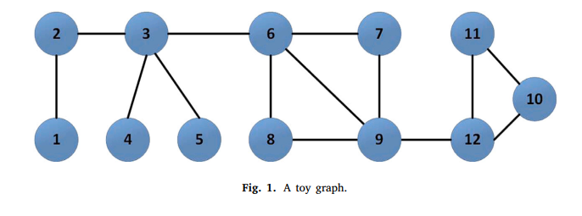
3.2 Continue…example explanation of LGC
A simple toy network to explain how LGC performs
consists of 12 nodes and 14 edges
Notes:
Based on the above procedure, we use a simple toy network to explain how LGC performs. Fig. 1 consists of 12 nodes and 14 edges; we take the influence of node 6 to illustrate LGC.

Slide 30
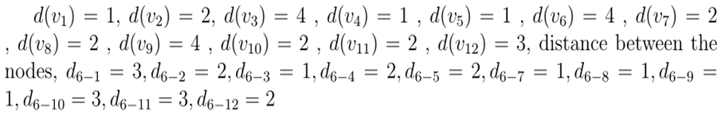
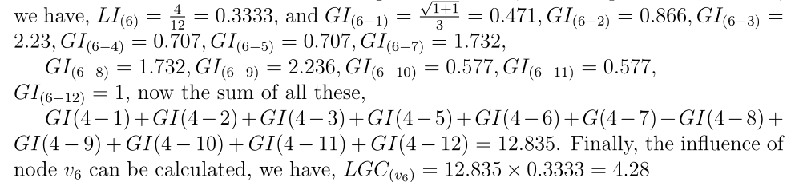
3.2 Continue…
To calculate the degree of each node:
To calculate the local-influence and global influence using the above two equations
Notes:
Based on the above procedure, we use a simplFirst, we calculate the degree of each node and the shortest distance between each node; we have, e toy network to explain how LGC performs. Fig. 1 consists of 12 nodes and 14 edges; we take the influence of node 6 to illustrate LGC.

Slide 31
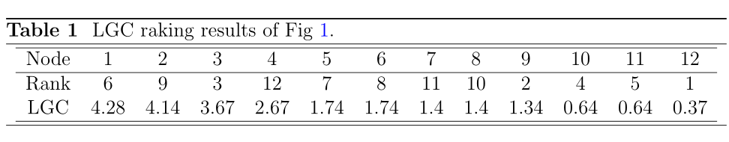
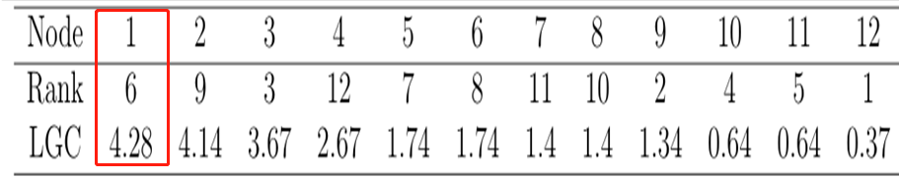
3.2 Continue…
Applying all of the above procedure, we get all nodes influence the ranking results of the given toy network
Notes:
Based on the above procedure, we use a simple toy network to explain how LGC performs. Fig. 1 consists of 12 nodes and 14 edges; we take the influence of node 6 to illustrate LGC.

Slide 32
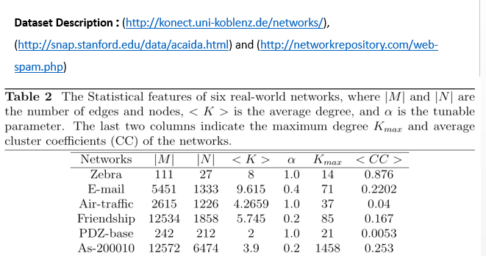
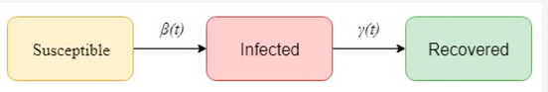
3.3 Experimentation analysis
01
System Configuration
02
Data set
03
Evaluation metrics
04
Effectiveness
The computational experiments are carried out under the system configuration, CPU: Feiteng 1500 A (1, 16-core, 1.5ghz), operating system: galaxy kirin server os Bios: China-made Kunlun firmware Memory: 32GB and Hard disk: 2TB
Kendall’s correlation coefficient 𝜏
Notes:
Susceptible (S) refers to a healthy state and can be infected by others. Infected (I) represents an infected state and can infect others. Recovered (R) represents a recovered state, which cannot be infected by others again. Initially, all seed nodes in the network are in a susceptible state. In each time period, the seed node can potentially infect its nearest and next-nearest neighbors with a certain probability 𝛽, then each node (infected node) enters the recovery state with probability 𝜇, where we set 𝜇 = 1. This process continues until there are no more affected nodes. Finally, all recovered nodes are used to replicate the effects of the original node.

Slide 33
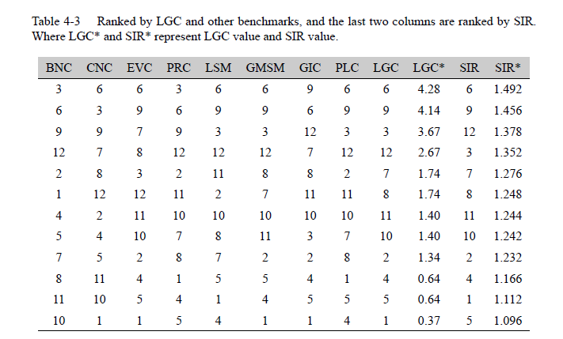
3.4 Effectiveness
Compared approaches: BNC, BNC, CNC, EVC, PRC, LSM, PLC, GLS, GSM, and GIC
Notes:
We used the SIR and Kendall's measurements to verify the effectiveness of LGC and compared the obtained results with BNC, CNC, EVC, PRC, PLC, GLS, GSM, and
GIC. First, we applied the proposed LGC on a simple toy network. Table 4-3 lists the ranking results of BNC, CNC,
EVC, PRC, PLC,GLS, GSM and GIC, as well as the SIR results of LGC. It can be seen that the LGC results are consistent with the evaluation order of the SIR, and its effect
outperforms other benchmarks.

Slide 34
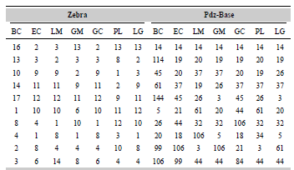
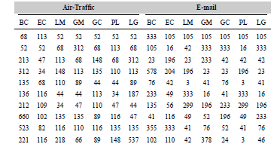
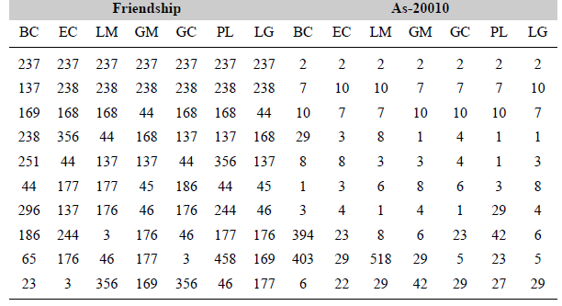
3.4 Effectiveness
Notes:
Based on the above procedure, we use a simple toy network to explain how LGC performs. Fig. 1 consists of 12 nodes and 14 edges; we take the influence of node 6 to illustrate LGC.

Slide 35
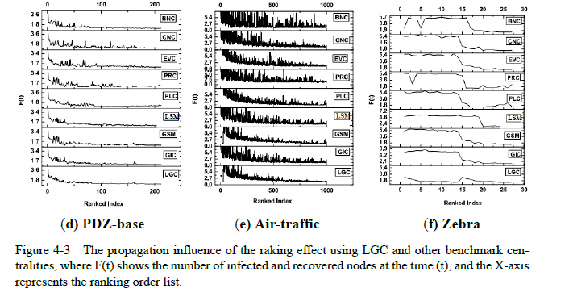
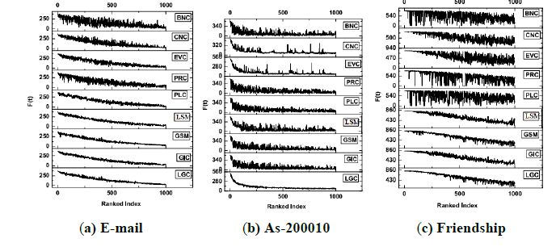
3.4 Continue….
Performance evaluation using SIR model
Notes:
Based on the above procedure, we use a simple toy network to explain how LGC performs. Fig. 1 consists of 12 nodes and 14 edges; we take the influence of node 6 to illustrate LGC.

Slide 36
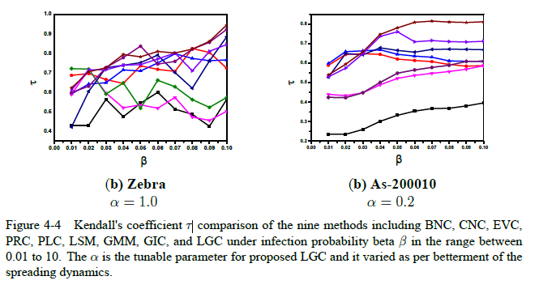
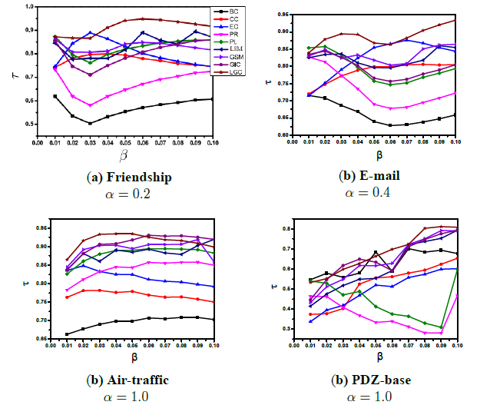
3.4 Continue….
Kendall's coefficient τ
Notes:
Based on the above procedure, we use a simple toy network to explain how LGC performs. Fig. 1 consists of 12 nodes and 14 edges; we take the influence of node 6 to illustrate LGC.

Slide 37
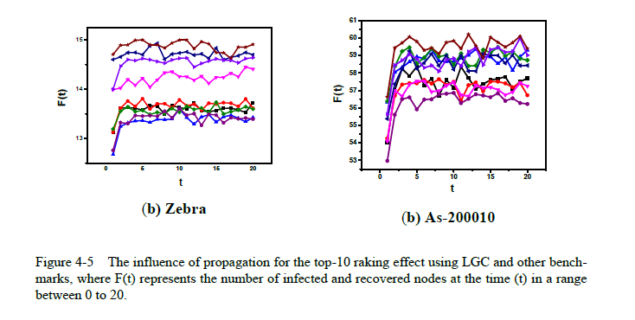
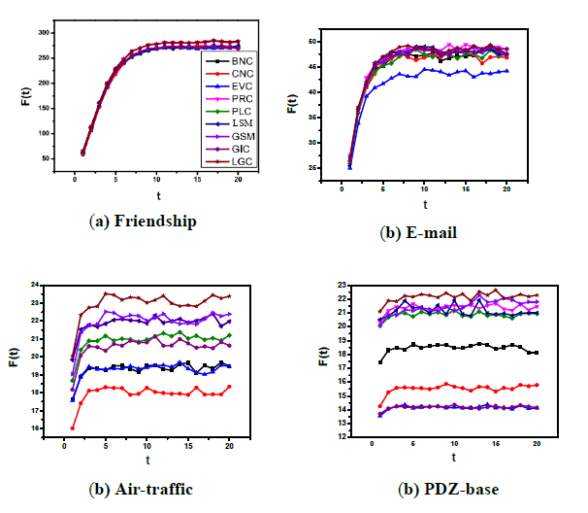
3.4 Continue…
The influence of propagation for the top-10
Notes:
Based on the above procedure, we use a simple toy network to explain how LGC performs. Fig. 1 consists of 12 nodes and 14 edges; we take the influence of node 6 to illustrate LGC.

Slide 38
3.5 Summary, advantages and disadvantages LGC
Applied six real-world networks and used standard evaluation criteria, SIR and Kendall's correlation coefficient τ methods, to analyze the spreading influence of ranking nodes
Experimental setup demonstrated that the proposed algorithm regarding accuracy and effectiveness is reasonable and significant as compared to the sorting algorithms
LGC limitations, it considers only the degree of a node in a network and a single degree may not be able to accurately assess the importance of nodes in a network, because the importance of the nodes mainly depends on the location of the nodes in a network and the number of their neighbors.
High Performance
Notes:
In this chapter,we have proposed a novel LGC, which comprises degree, tunable parameter and shortest path between the nodes to filter out the vital nodes in spreading
dynamics. Further, LGC is applied pragmatically on different scale-sized real-world. networks and used SIR and Kendall's measurements to evaluate its efficiency. The experimental
results based on these real networks showed that the proposed LGC is better than the existing methods. Therefore, to overcome this problem, in the next Slid, we incorporate the degree
and k-shell of a node into LGC and design NPIC to further enhance its performance.

Slide 39
GSM: A global-based structure model in complex networks for identification of nodes influence
Overview of previous NPIC limitations
Part 4
Proposed GSM
Experimentation and results analysis
Summary of GSM

Slide 40
4.1 Overview of previous NPIC limitations
To obtain the optimum values of tunable parameters of a network, we need to run the simulation process multiple times
To solve this problem, deigned GSM without providing prior parameter configuration (tunable parameter), and incorporated only the k-shell mechanism
The performance of GSM is evaluated on real-world and artificial networks
GSM outperformed many of the compared techniques
Notes:
In the previous chapter 5, we have seen that the NPIC is the best indexing technique to filter out the vital nodes in spreading dynamics. But to obtain the optimum values of
tunable parameters of a network, we need to run the simulation process multiple times. To solve this problem, in this chapter, we have designed a new model (GSM) without
providing prior parameter configuration (tunable parameter), and incorporated only the
kshell mechanism. The proposed model considers neighborhood information and path information without giving parameter configuration in advance.

Slide 41
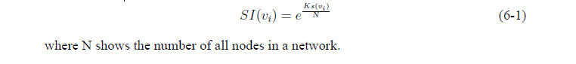
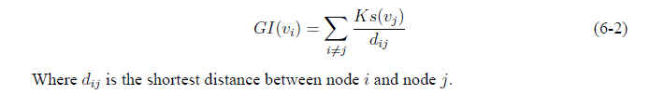
4.2 Proposed GSM
Self-influence: In this context, we used e (natural logarithm) and take k-shell Ks(vi), and nodes
number (N) in the network as power parameters to minimize the overestimation of the self-influence
Global-influence: The node influence also considers the influence of the other connected nodes to it. Normally, the node influence is increased if its neighborhoods have a high value of k-shell; however, the contact distance between the two nodes cannot be ignored, which is inversely proportional to the influence of the nodes.

Slide 42
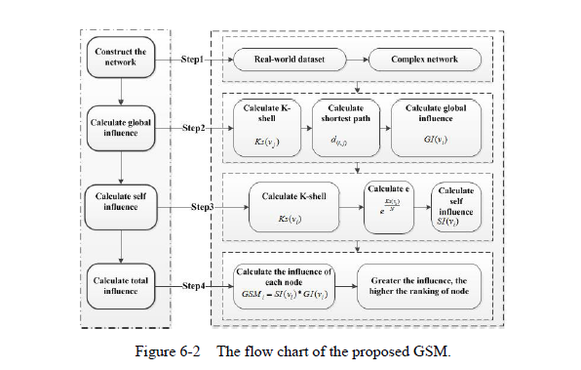

4.2 Continue…
Node influence: The node Vi influence is not only on its own influence but also on the nodes around
it. Therefore, the proposed GSM simultaneously considers these two aspects, self and global influence, which can be defined as,

Slide 43

4.2 Continue…computation process
A simple toy network to explain how GSM performs
Figure 6-1 A network with 17 edges and 13 nodes
Notes:
Based on the above procedure, we use a simple toy network to explain how LGC performs. Fig. 1 consists of 12 nodes and 14 edges; we take the influence of node 6 to illustrate LGC.

Slide 44

5.3 Experimentation and results analysis
Data set:
Notes:
Based on the above procedure, we use a simple toy network to explain how LGC performs. Fig. 1 consists of 12 nodes and 14 edges; we take the influence of node 6 to illustrate LGC.

Slide 45


4.3 Continue…
Kendall’s coloration results:

Slide 46


4.3 Continue…
Propagation influence of top-10:
Notes:
Based on the above procedure, we use a simple toy network to explain how LGC performs. Fig. 1 consists of 12 nodes and 14 edges; we take the influence of node 6 to illustrate LGC.

Slide 47
4.4 Summary
Addressed the problem of identification of nodes influence in complex networks from micro viewpoint
Conducted experiments on virus sized of real-world datasets
the proposed algorithms (LSM, LGC, NPIC, and GSM) are excellent predictors in identifying the influential nodes in complex networks (for example, real-networks and artificial networks)
The complex networks structures from meso-level (community detection).
Notes:
we have we addressed the problem of identification of nodes influence in complex networks from micro viewpoint. Further, we have visualized
and analyzed the different network structures such small and large-scales networks. Using these various sizes of network e.g. real and artificial networks, and proposed various
centrality measures on the basis of local and global structures. The experimental results have shown that the proposed algorithms (LSM, LGC, NPIC, and GSM) are excellent
predictors in identifying the influential nodes in complex networks (for example, real-networks and artificial networks). All of these algorithms are used for complex networks
from micro-level (influential nodes identification). In the next chapter 7, we will study the complex networks structures from meso-level (community detection).

Slide 48
RIIM: A novel relevance-based information interaction model for community detection in
complex networks
An overview of community detection
Part 6
Existing methods and problems
Proposed method
Experimental evaluation
RIIM Summary

Slide 49



6.1 An overview of community detection
Complex networks structures from meso-level (community detection)
Community detection, also called graph partition, helps us to reveal the hidden relations among the nodes in the network; community detection in a network is identifying sets of nodes in such a way that the connections of nodes within a set are more than their connection to other network nodes
Currently, there is no clear definition of what a community is. Generally, a community refers to a set of nodes with similar attributes in the network
Notes:
In the previous chapters, we have we addressed the problem of identification of nodes influence in complex networks from micro viewpoint. Further, we have visualized
and analyzed the different network structures such small and large-scales networks.

Slide 50

6.1 Continue…
In the real world, many networks have community structures
Notes:
what is dynamic community: Community dynamics are the changes in community structure and composition over time, often following environmental disturbances such as volcanoes, earthquakes, storms, fires, and climate change.
What are overlapping communities?
Overlapping communities are possible if a node is a member of more than one community.

Slide 51

6.2 Existing methods and problems
Some existing methods have problems such as parameter setting and prior knowledge, such as FluidC, Kuramoto synchronization etc.
There are some methods that consider local information,
such has LDC, MCL, WLA etc.
Local-based structure
Global-based structure
Parameter setting
Some existing methods only consider global information , such as GN divide and agglomerate algorithm (DAA), etc.
Notes:
Local community detection refers to finding the community that contains the given node based on local information, which becomes very meaningful when global information about the network is unavailable or expensive to acquire.
To cope with these research issues, an effective community detection approach is required to feasibly alleviate the computational overhead
of dealing with the network. Therefore, we propose a novel Relevance-based Information Interaction Model
(RIIM) to identify communities in complex networks based on local as well as global topological aspects without
providing prior community knowledge and parameter configuration.

Slide 52




6.3 Proposed RIIM
Method:

Slide 53
6.3 Continue…

Slide 54





6.3 Continue…computation process
Figure 7-1 A toy graph

Slide 55
6.4 Experimental evaluation
1
3
2
4
Comparing algorithms
Evaluation metrics
LPA
FG
FluidC
LE
GN
Commansor
CDID
NMI
ARI
Purity
Modularity
Data set
Performance comparison
Synthetic networks LFR generator model
Real networks with ground truth
Real networks with ground truth
Generative network
Real network
Notes:
LPA (Raghavan et al., 2007): LPA is a famous graph label propagation
algorithm. Due to the linear time complexity, it is suitable
for large-scale networks and can quickly find the community
structure.
• Fastgreedy (FG) (Clauset et al., 2004a): FG is a modularity optimization
method, based on a greedy algorithm to optimize
modularity to find the community structure.
• FluidC (Parés et al., 2017) : It works also on the basis of label
propagation, which reproduces the process of fluids growing and
contracting to uncover the structure of community.
• Leading-Eigenvector (Newman, 2001): LE detects communities by
calculating the leading eigenvector of the modularity matrix.
• GN (Newman, 2013): GN is working on the principle of betweenness,
introduced by Newman and Girvan, this technique is widely
used but is not suitable for large-scale networks due to its high
time complexity.
• Commansor (Sheng et al., 2019): This algorithm identifies communities
based on social human behavior in a network.
• CDID (Sun et al., 2019): It is recently proposed by sun et al. in
2019. It can automatically find community structures in complex
networks and suitable for both small and large-scale networks.

Slide 56


6.4 Continue…
Compare datasets:
Used LFR model to validate the effectiveness of the proposed model
Real-data set with ground truth
Real-data set without with ground truth
Notes:
We used the popular benchmark LFR model to validate the effectiveness of the proposed model. The features of the LFR model are somewhat similar to real networks,
such as degree, community size, overlap, and average clustering coefficient.

Slide 57





6.4 Experimental evaluation
Experimental Evaluation Methods

Slide 58


6.4 Continue…
Model performance using real networks with ground truth
Model performance using real networks with ground truth

Slide 59



6.4 Continue…
Visualization of Karate, Dolphin, UmBlog, and Politics-books networks using proposed RIIM

Slide 60

6.4 Continue…
Model performance using synthetic networks
Notes:
While the proposed method aims to identify communities, there are many complex networks in the real world, but we do not understand the real ground reality. Therefore,
to test the proposed method for synthetic networks, we used the benchmark generator model by varying the mixing parameter μ. The performance of the benchmarks and
RIIM based on three evaluation metrics (NMI, ARI and Purity ) are shown in Fig

Slide 61

6.4 Continue…
Model performance using synthetic networks
Notes:
Fig. 7-6 indicates the comparative performance of the proposed RIIM and seven benchmarks, including CDID, Commansor, FG, GN, LE, FluidC, and LPA, on LFR
networks with average degree < k > ranging from 5 to 30.

Slide 62

6.4 Continue…
Model performance using synthetic networks
Notes:
Furthermore, to evaluate RIIM and other benchmarks for large-scale LFR networks, we changed the number of nodes from 5k to 30k. Fig. 7-7 indicates the comparative
performance of the proposed RIIM and seven benchmarks on the large-scale
LFR networks (N=5000 to N=30,0000).

Slide 63

6.4 Continue…
Running time of RIIM
Notes:
To evaluate the proposed RIIM scalability on different networks sizes, we have used LFR benchmark to generate different networks with the number of nodes from 1k
to 30k and set some other parameters such as average degree k = [10 − 20], maximum degree kmax = [20 − 50] and μ = 0.1. Fig. 7-8 indicates the running time of RIIM
and other benchmarks, from which we note that RIIM is faster than GN and CDID algorithm due to its time complexity of O(n2 + e). The high time complexity of GN
causes its running time to increase steeply with the number of nodes, and when the number exceeds 10, 000, it is no longer possible to produce results in an acceptance
time, therefore the data for GN in the figure does not full display.

Slide 64
6.5 RIIM Summary
Extensive experiments on real and synthetic networks, and the generated performance demonstrates that the proposed approach outperformed the state-of-the-art techniques by effectively identifying the corresponding communities in complex networks
1
2
3
Both local as well as global information
No parameter setting
Can be applied to large networks

Slide 65
Conclusions
Dissertation work Conclusions
Part 7
Limitations and future recommendations
Acknowledgments

Slide 66
7.1 Dissertation work Conclusions
1. LSM
2. LGC
A local structure-based model (LSM) is proposed for identifying influential nodes in complex networks. LSM comprises factors such as the k-shell, degree nodes, and numerous levels of neighbor's influence or neighborhood potential
A local and global centrality (LGC) measuring algorithm is presented for identifying critical nodes in a network by simultaneously managing local and global topological aspects
2.1. NPIC
A neighborhood and path information-based centrality (NPIC) is proposed that considers both neighborhood and path information's to identify the influential spreaders in a concern networks
1
2
3 GSM
3
4
A novel approach is proposed to identifying influential nodes in complex networks called global structure model (GSM), which takes into account self-influence and emphasizes the global influence of nodes in a network
4. RIIM
A novel Relevance-based Information Interaction Model (RIIM) is proposed to identify communities in complex networks based on local as well as global topological aspects without providing prior community knowledge and parameter configuration

Slide 67
7.2 Limitations and future recommendations
Fourth
we plan to transform the assessment of node influence into a classification problem and design several algorithms on the basis on machine learning
Third
Second
Throughout all the experiments, we have employed the SIR model as a standard simulator to validate the effectiveness of the indexing methods (for influential nodes identifications models)
First
We have observed that the proposed models (LSM, LGC, NPIC, GSM and RIIM) have a slightly higher computational complexity except LSM which has linear time complexity. Therefore, in the future, we intend to use parallel computing to enhance these models
One of the limitations of this research work is that the methods and models proposed are designed only for undirected and nun-weighted networks
Notes:
However, this model does not consider all the circumstances which usually happen in a real spreading scenario

Slide 68
7.3 Acknowledgments
First and foremost, I would like to express my deepest gratitude to Almighty Allah, most merciful and most beneficent, for giving me the strength, courage, and commitment to work on my Ph.D Research field throughout my studies at Central South University in China. Also, I would like to thank China’s government, China Scholarship Council (CSC), for providing me with this opportunity.
I would like to express my profound gratitude and deep regards to my supervisors Dr. Prof. Wang Bin , Dr. Prof. Jun Long, Dr. Prof. JinF Sheng.
I would like to extend a special thanks Dr. Professor Sheng for carefully guiding me throughout my whole PhD work, such as papers publication guidance and thesis guidance.
Finally I extend my gratitude to the entire faculty members of CSU (School of Computer science
and Engineering ) for their well wishes.

Slide 69

2018 School of Computer Science and Engineering
The report is complete
Doctoral research dissertation
Presenter：Aman Ullah Mentor: Professors: Wang Bin

